Slide 1


Get it done with Azure automation
Kurt van Hoecke | Inovativ | MVP | @Bunkco
Stijn Callebaut | Inovativ | @StijnCa

Slide 2

Agenda
Position Azure Automation within OMS
Provide an overview of Azure Automation capabilities
Runbooks and Assets
Security
Configuration management

Slide 3
Azure Automation ?!
Is part of something larger, called OMS
Used to automate processes
Enables configuration management
Talks to any cloud or on-premises infrastructure

Slide 4
What makes up Azure automation?
Runbooks
(scripts, workflows and graphical)
Assets
(Modules, variables, credentials, certificates, connections and schedules)
Hybrid workers
Jobs
Configurations
(DSC Configurations, DSC Node configurations and DSC nodes)
= Automation Account

Slide 5
Demo: Automation resources

Slide 6
Runbook Authoring
Azure portal
Text editor
Graphical editor
PowerShell ISE
Visual studio
Visual studio code
….

Slide 7
Interaction
How can we interact with Azure Automation runbooks?
Via the portal (start, stop action buttons)
Using the Azure automation PowerShell module
Azure Resource Manager (ARM) API
Azure automation Schedules
Azure Alerts
Another runbook
Webhooks

Slide 8
Demo: Interaction with runbooks

Slide 9
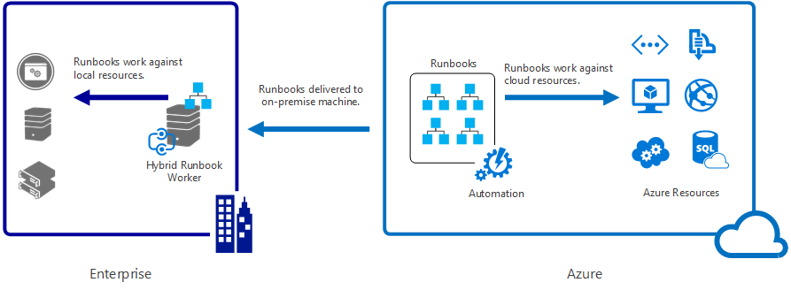
Going hybrid

Slide 10
Demo: Hybrid runbook worker

Slide 11
Auditing
Azure portal
OMS
Joblogs
Jobstreams

Slide 12
auditing
Get insight on your Automation jobs
Trigger an email or alert based on your runbook job status (e.g. failed or suspended)
Write advanced queries across your job streams
Correlate jobs across Automation accounts
Visualize your job history over time

Slide 13
Demo: Logs in OMS

Slide 14
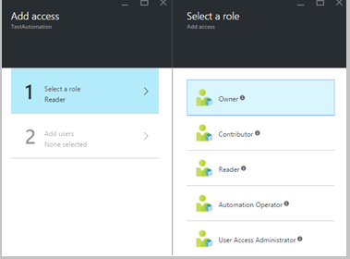
Security
Role based Access management capabilities to segregate duties
At the Automation Account level
Roles:
Owner
Contributor
Reader
Automation operator
User access administrator
Note: access is Inherited for service administrators and co-admins of a subscription and it’s Assigned for all the other users.

Slide 15
Configuration management
Azure automation DSC
Is a DSC pull server as a service
Deploy, update and monitor the desired state
Can manage any VM (Windows, Linux) in any location (Azure,AWS, on-prem,..)
Builds on top of PowerShell DSC (desired state configuration)
More on DSC by Ed Wilson (aka The scripting guy)

Slide 16
Questions?

